Slide 1

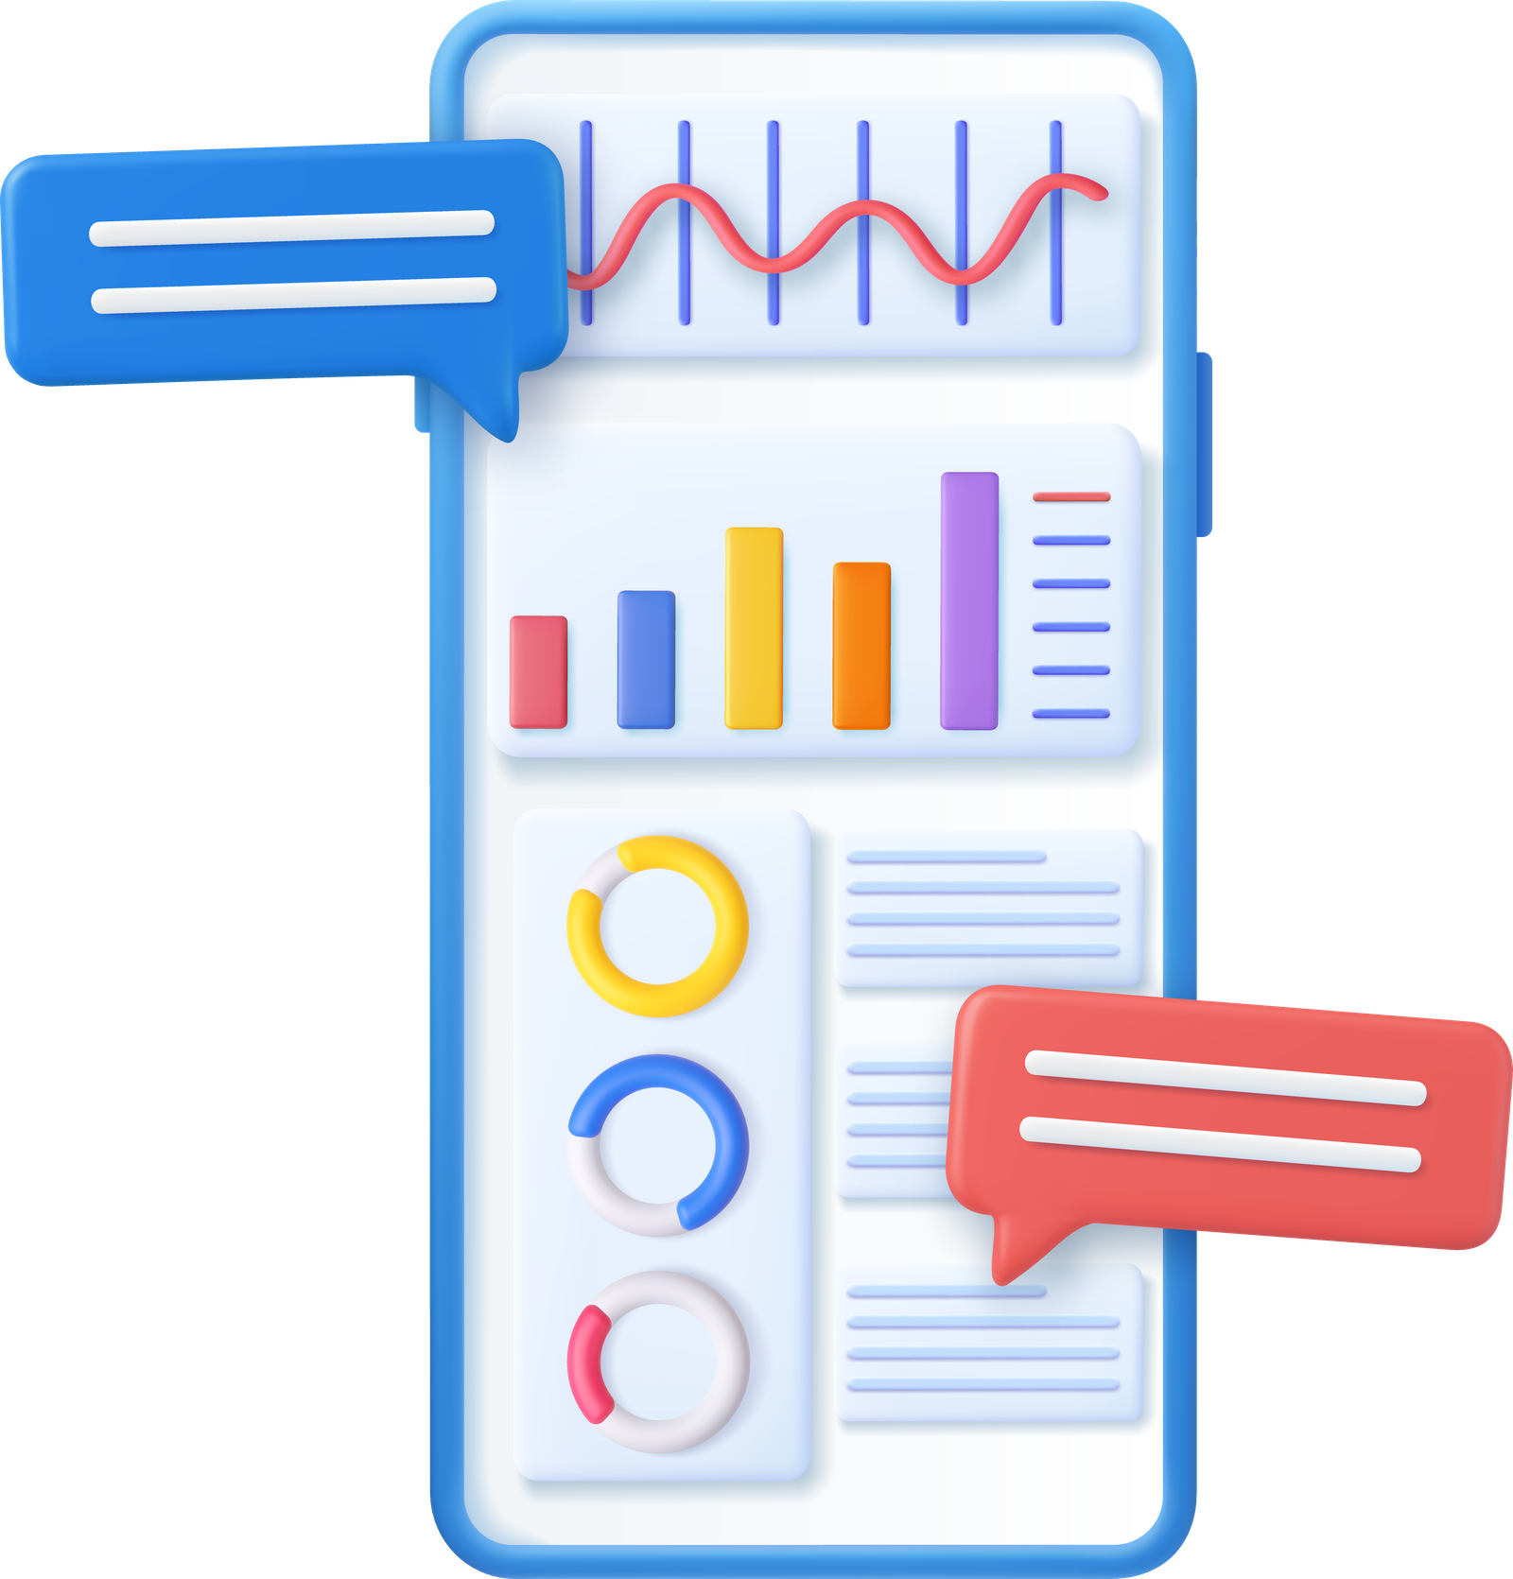

DATA
SCIENCE

Slide 2

With the vast amounts of data available today, data science helps make sense of it all by using statistical and computational methods to extract meaningful insights
DATA SCIENCE
IS THE ART
OF TURNING RAW
DATA INTO INSIGHTS

Slide 3

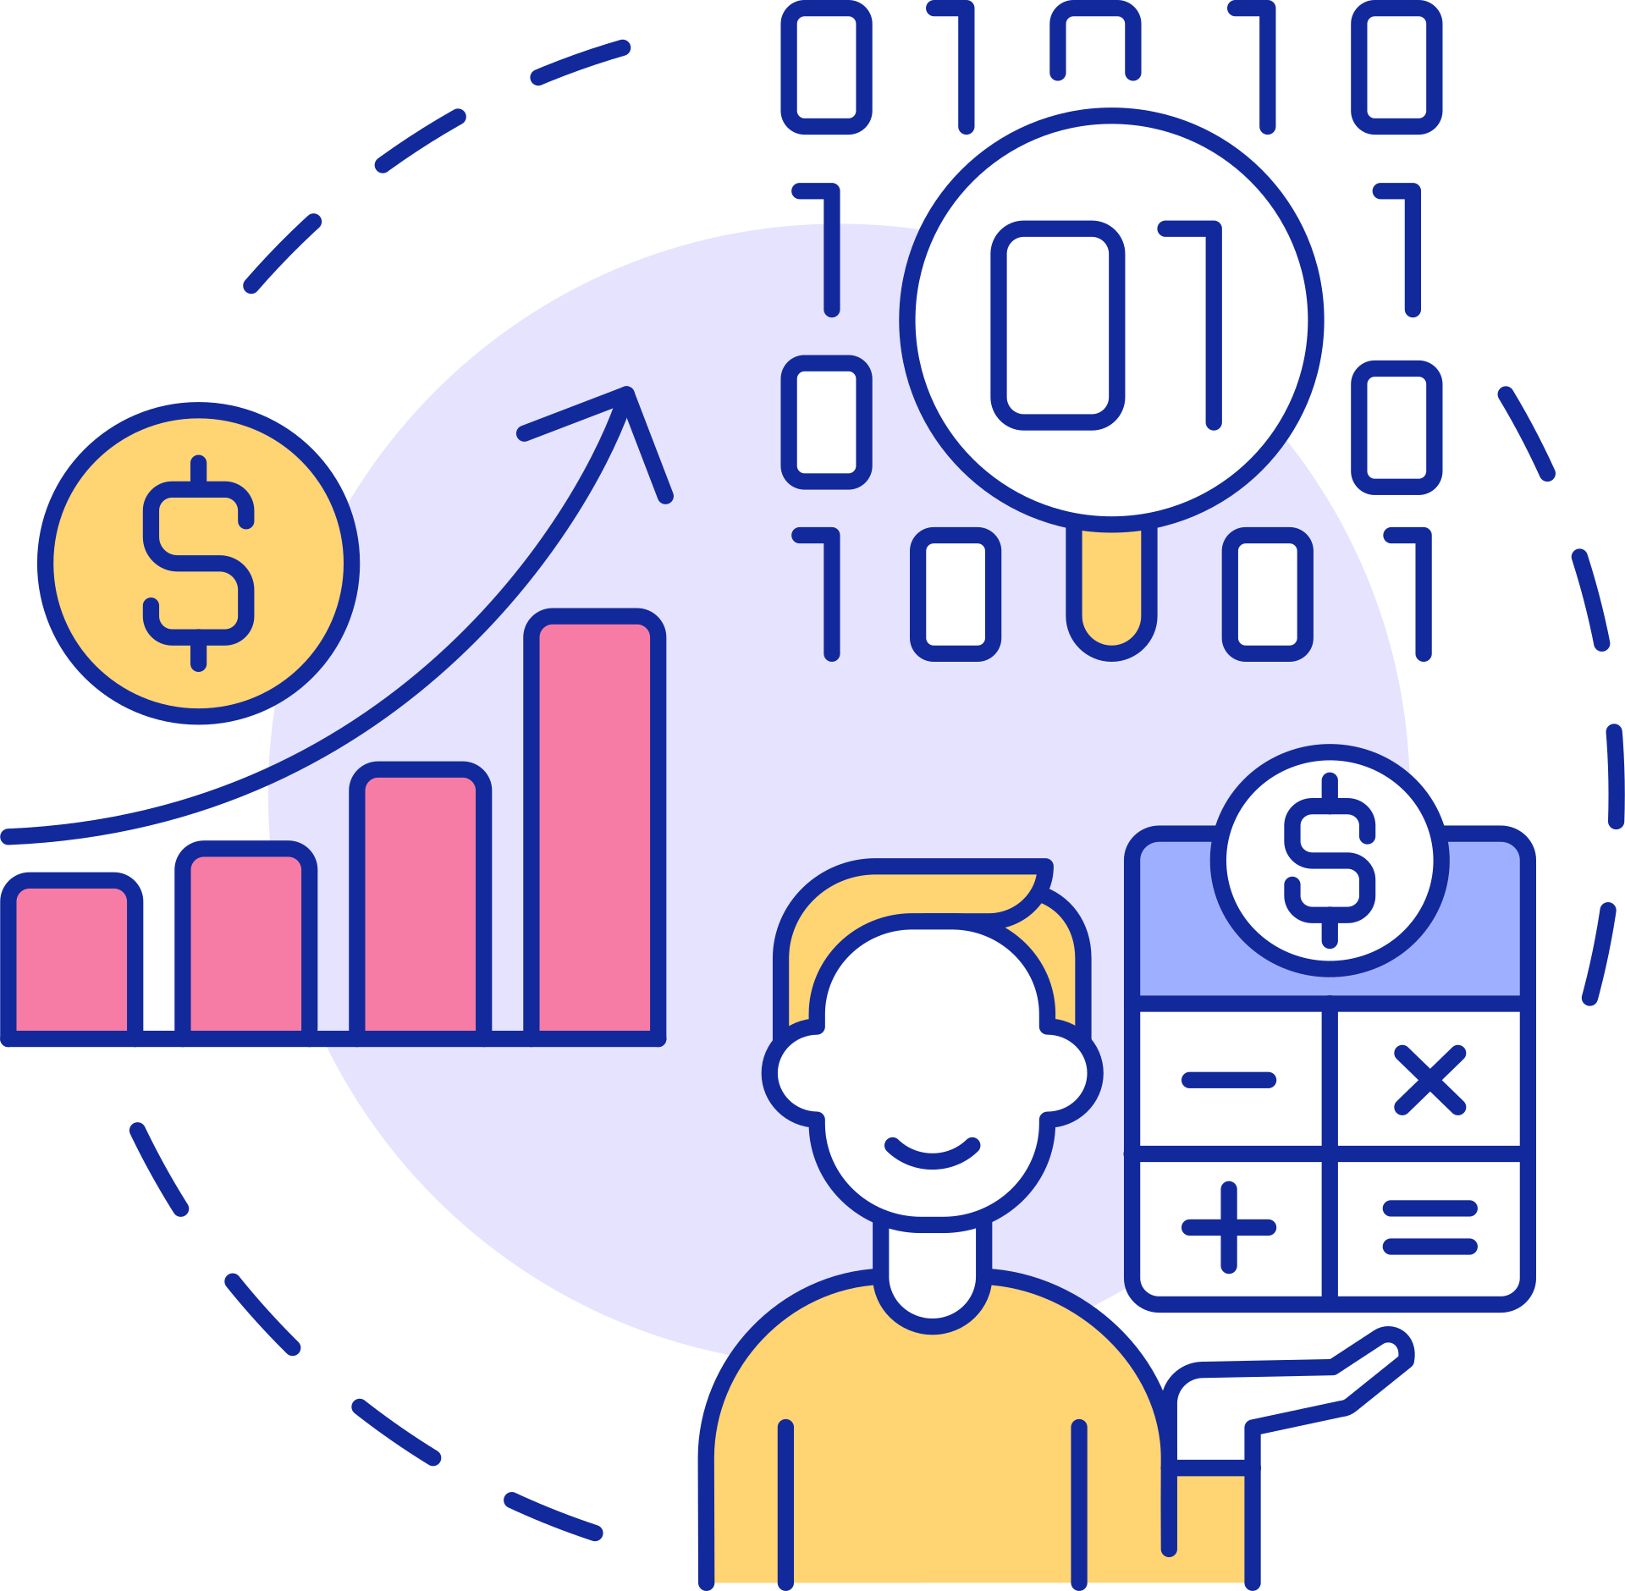
In today's data-driven world, businesses and organizations of all kinds rely on data to make informed decisions.
Data science plays a critical role in this process by providing the tools and methods needed to extract valuable insights from data.
DATA SCIENCE
IS THE
FUTURE OF DECISION-MAKING

Slide 4

While data science has traditionally been associated with technical fields like computer science and statistics, it's becoming increasingly important across all industries and disciplines.
Anyone can benefit from learning data science skills, whether they're working in healthcare, finance, marketing, or any other field.
DATA SCIENCE IS FOR EVERYONE

Slide 5
APPLICATIONS OF
DATA SCIENCE

Slide 6


DISEASE DIAGNOSIS AND PREDICTION
HEALTH
CARE
Algorithms can be trained on large amounts of patient data to identify patterns and predict the likelihood of certain diseases or conditions.
For example, predictive models can be used to identify patients at high risk of developing diabetes, heart disease, or other conditions.

Slide 7


PREDICTIVE ANALYTICS
Data science can be used to predict various financial outcomes, such as stock prices, interest rates, and economic indicators.
This can help financial institutions make more informed decisions about investments and other financial activities.
FINANCE

Slide 8


DRUG DISCOVERY AND DEVELOPMENT
Data science techniques can be used to analyze large datasets and identify new drug targets or potential therapies.
Data science models can also be used to predict the efficacy and safety of drugs before they are tested in clinical trials.
PHARMACEUTICAL
INDUSTRY

Slide 9


CUSTOMER SEGMENTATION AND TARGETING
Data science techniques can be used to segment customers based on behavior and preferences, such as which products they are likely to purchase or which marketing messages they are likely to respond to.
This can help marketers develop more targeted and personalized marketing campaigns.
MARKETING

Slide 10


CROP YIELD PREDICTION
Data science can be used to analyze historical crop yield data and predict future yields based on various factors, such as weather patterns, soil conditions, and irrigation practices.
This can help farmers better plan their operations and make more informed decisions about crop selection and planting schedules.
AGRICULTURE

Slide 11

TYPES
0F
DATA SCIENCE

Slide 12
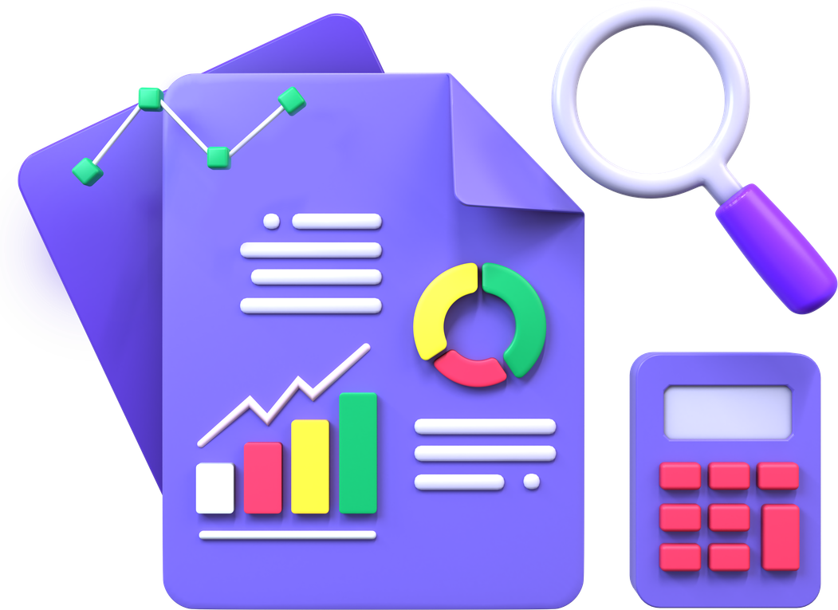
  DESCRIPTIVE DATA SCIENCE
  DIAGNOSTIC DATA SCIENCE
  PREDICTIVE DATA SCIENCE
  PRESCRIPTIVE DATA SCIENCE
TYPES
OF
DATA SCIENCE

Slide 13
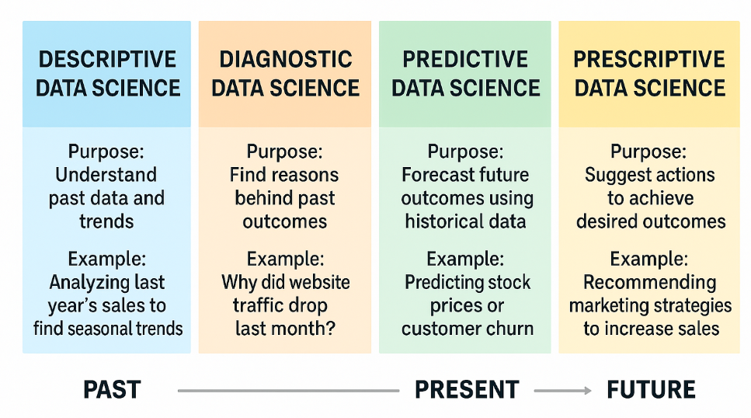

Slide 14
TOOLS
FOR
DATA SCIENCE

Slide 15
  PYTHON PROGRAMMING
  DATA VISUALIZATION
  MACHINE LEARNING
  NATURAL LANGUAGE PROCESSING
  DEEP LEARNING
  MATHEMATICS & STATISTICS
TOOLS
FOR
DATA SCIENCE

Slide 16


MACHINE
LEARNING ?
creating algorithms and models capable of making informed choices or decisions by processing data and learning from it.

Slide 17



ML Algorithm
Analysis
&
Preprocessing
Data

Slide 18

DEEP
LEARNING ?
it is a specialized field within machine learning where artificial neural networks are employed to process and analyze complex data.

Slide 19
Analysis
&
Preprocessing
Neural
network
Data

Slide 20
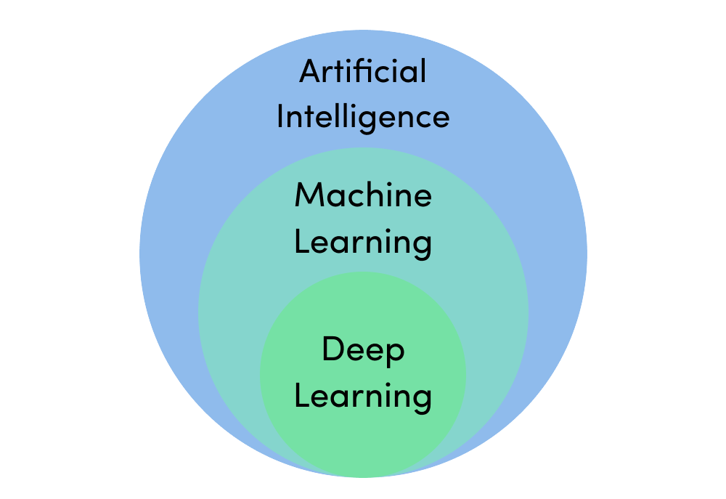

Slide 21
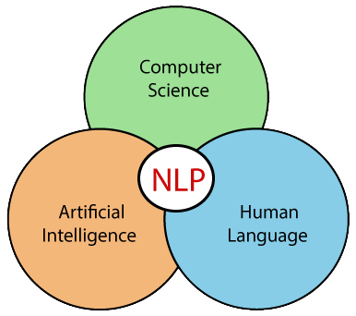

Slide 22

NATURAL LANGUAGE PROCESSING (NLP)

Slide 23

NATURAL LANGUAGE
PROCESSING (NLP) ?
NLP is a machine learning technology that gives computers the ability to interpret, manipulate, and comprehend human language.

Slide 24
TYPES OF
MACHINE LEARNING

Slide 25
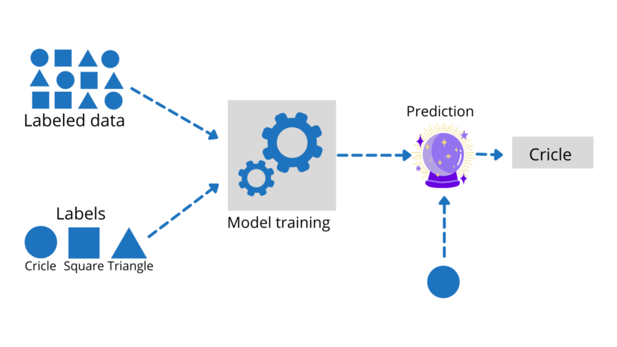
1. SUPERVISED LEARNING

Slide 26
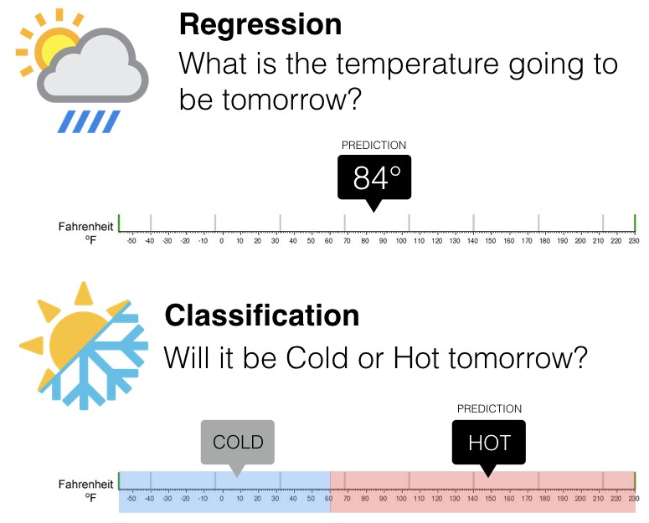
1. SUPERVISED LEARNING

Slide 27
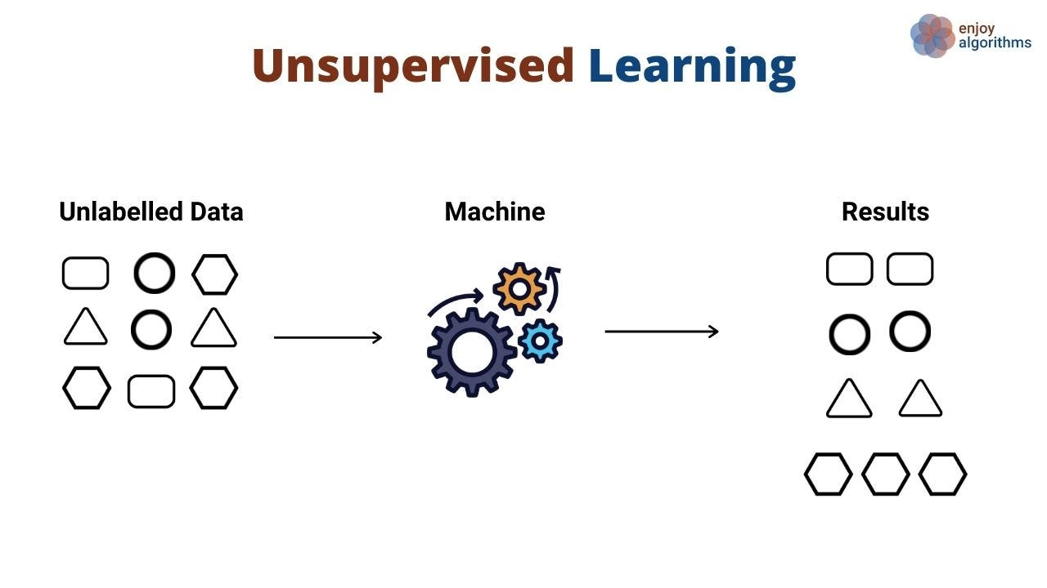
2. UNSUPERVISED LEARNING

Slide 28
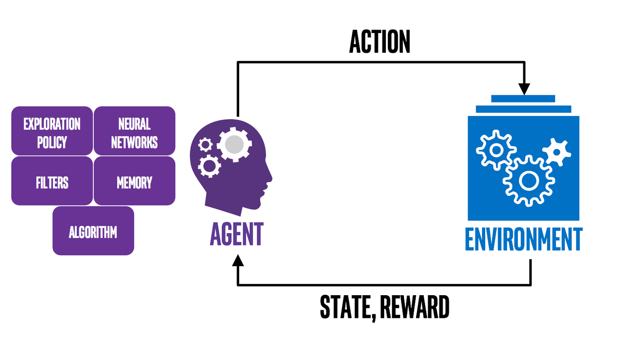
3. REINFORCEMENT LEARNING

Slide 29
  Data collection
  Preprocessing
  train, test, split
  Feature selection
  Model - selection, training
  Predictions
  Evaluate and improve
Steps
in
Machine
Learning

Slide 30


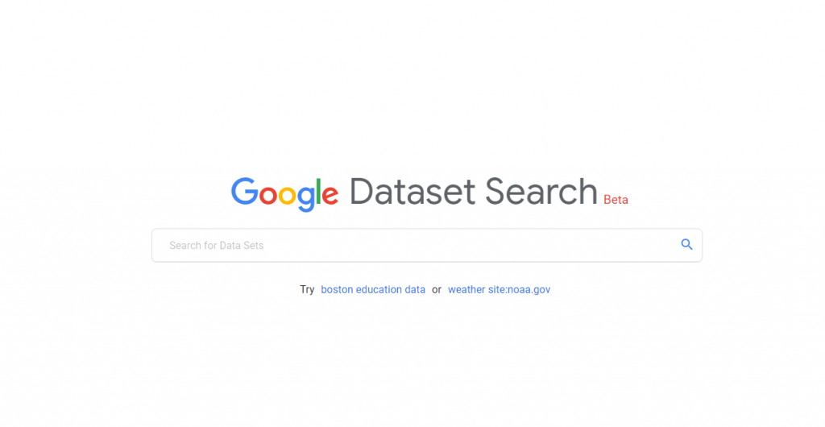
DATA COLLECTION
  Kaggle
  UCI machine learning repository
  Google dataset search

Slide 31
  Feature Scaling
  Encoding
  Imputing null values
  Outlier - detection & Handling
PREPROCESSING

Slide 32
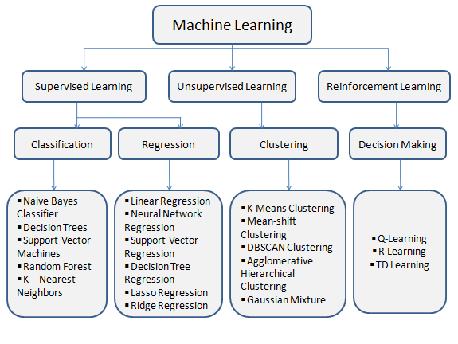
ALGORITHMS

Slide 33

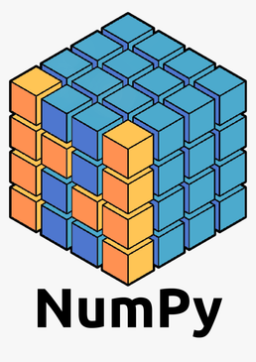
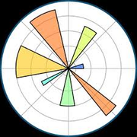


MOST COMMON USED TOOLS IN DATA SCIENCE
Pandas
Numpy
Matplotlib
Seaborn
Scikit-learn

Slide 34




THANK YOU

